Slide 1
Chapter 2. Data, Measurements, and Data Preprocessing
Data Types
Statics of Data
Similarity and Distance Measures
Data Quality, Data Cleaning and Data Integration
Data Transformation
Dimensionality Reduction

Slide 2
Dimensionality Reduction
What Is Dimensionality Reduction?
Dimensionality Reduction Methods
Principal Component Analysis
Attribute Subset Selection
Nonlinear Dimensionality Reduction Methods

Slide 3
What Is Dimensionality Reduction?
Curse of dimensionality
When dimensionality increases, data becomes increasingly sparse
Density and distance between points, which is critical to clustering, outlier analysis, becomes less meaningful
The possible combinations of subspaces will grow exponentially
Dimensionality reduction
Reducing the number of random variables under consideration, via obtaining a set of principal variables
Advantages of dimensionality reduction
Avoid the curse of dimensionality
Help eliminate irrelevant features and reduce noise
Reduce time and space required in data mining
Allow easier visualization
Notes:
3
JH: put SVD at clustering high-D reduction.

Slide 4
Dimensionality Reduction Methods
Dimensionality reduction methodologies
Feature selection: Find a subset of the original variables (or features, attributes)
Feature extraction: Transform the data in the high-dimensional space to a space of fewer dimensions
Some typical dimensionality reduction methods
Principal Component Analysis
Attribute Subset Selection
Nonlinear Dimensionality Reduction
Notes:
4
JH: put SVD at clustering high-D reduction.

Slide 5
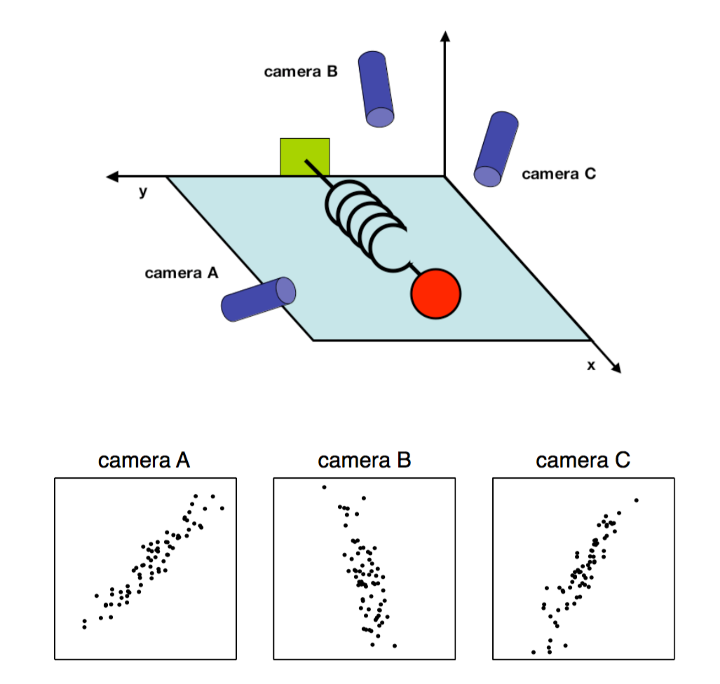
Principal Component Analysis (PCA)
PCA: A statistical procedure that uses an orthogonal transformationto convert a set of observations of possibly correlated variables into a set of values of linearly uncorrelated variables called principal components
The original data are projected onto a much smaller space, resulting in dimensionality reduction
Method: Find the eigenvectors of the covariance matrix, and these eigenvectors define the new space
Ball travels in a straight line. Data from three cameras contain much redundancy

Slide 6
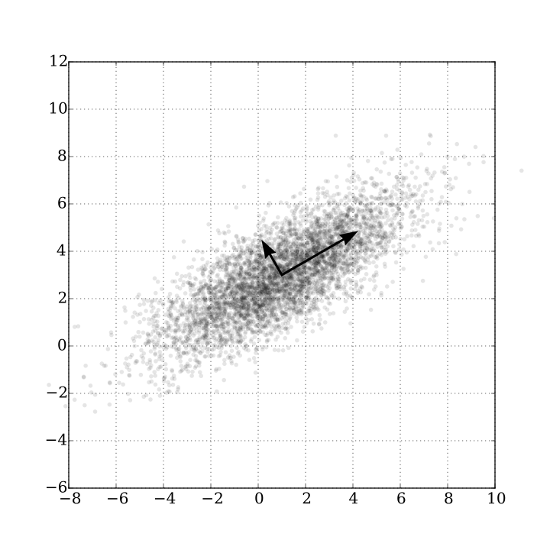
Principal Component Analysis (Method)
Given N data vectors from n-dimensions, find k ≤ n orthogonal vectors (principal components) best used to represent data
Normalize input data: Each attribute falls within the same range
Compute k orthonormal (unit) vectors, i.e., principal components
Each input data (vector) is a linear combination of the k principal component vectors
The principal components are sorted in order of decreasing “significance” or strength
Since the components are sorted, the size of the data can be reduced by eliminating the weak components, i.e., those with low variance (i.e., using the strongest principal components, to reconstruct a good approximation of the original data)
Works for numeric data only
Ack. Wikipedia: Principal Component Analysis

Slide 7
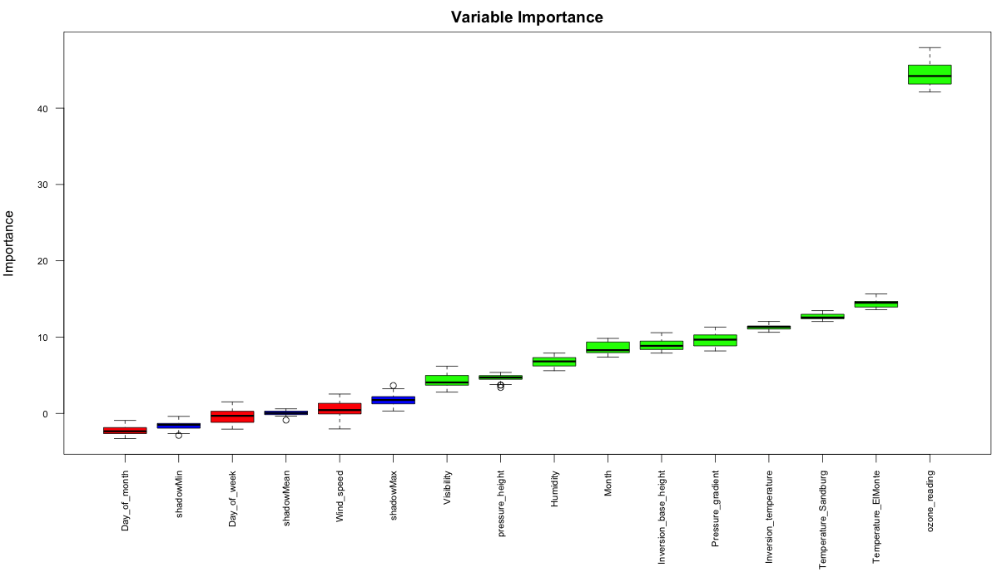
Attribute Subset Selection
Another way to reduce dimensionality of data
Redundant attributes
Duplicate much or all of the information contained in one or more other attributes
E.g., purchase price of a product and the amount of sales tax paid
Irrelevant attributes
Contain no information that is useful for the data mining task at hand
Ex. A student’s ID is often irrelevant to the task of predicting his/her GPA

Slide 8
Heuristic Search in Attribute Selection
There are 2^{d} possible attribute combinations of d attributes
Typical heuristic attribute selection methods:
Best single attribute under the attribute independence assumption: choose by significance tests
Best step-wise feature selection:
The best single-attribute is picked first
Then next best attribute condition to the first, ...
Step-wise attribute elimination:
Repeatedly eliminate the worst attribute
Best combined attribute selection and elimination
Optimal branch and bound:
Use attribute elimination and backtracking

Slide 9
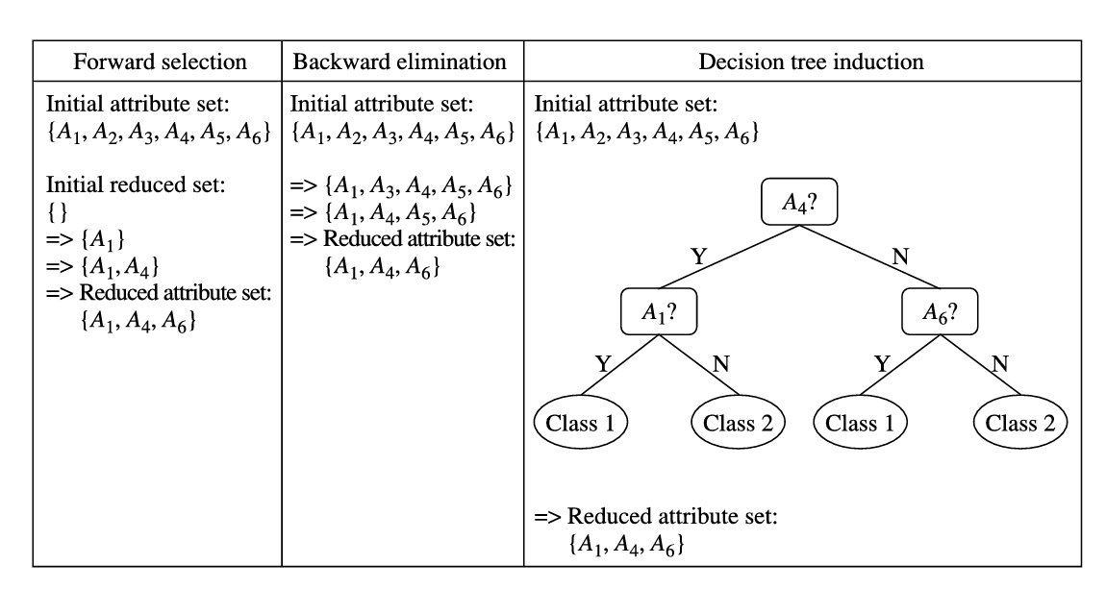
Heuristic Search(启发式搜索) in Attribute Selection
Notes:
9

Slide 10
Attribute Creation (Feature Generation)
Create new attributes (features) that can capture the important information in a data set more effectively than the original ones
Three general methodologies
Attribute extraction
Domain-specific
Mapping data to new space (see data reduction)
E.g., Fourier transformation, wavelet transformation, manifold approaches (not covered)
Attribute construction
Combining features (see discriminative frequent patterns in Chapter on “Advanced Classification”)
Data discretization
Notes:
10

Slide 11
Nonlinear Dimensionality Reduction Methods
PCA is a linear method for dimensionality reduction
Each principal component is a linear combination of the original input attributes
It works well if the input data approximately follows a Gaussian distribution or forms a few linearly separable clusters
When the input data is linearly inseparable, we need to construct a proximity matrix (P) and learn a new matrix with k features (k << d) that preserves the proximity

Slide 12
Nonlinear Dimensionality Reduction (I): Kernel PCA (KPCA)
Use a kernel function κ(·) to construct the kernel matrix: P(i, j) = κ(x_{i}, x_{j}), and learn the best low-dimensional representations so that the estimated proximity matrix Pˆ is as close as possible to the kernel matrix P
This can be obtained by using top-k eigenvectors and eigenvalues of the kernel matrix P
Typical kernel functions:
(1) polynomial kernel:
(2) radial basis function (RBF):
If we choose a linear kernel: κ(x_{i} , x_{j}) = x_{i}・x_{j}, KPCA degenerates to the standard PCA
Major formulas of Kernel PCA vs. SNE (Stochastic neighborhood embedding)

Slide 13
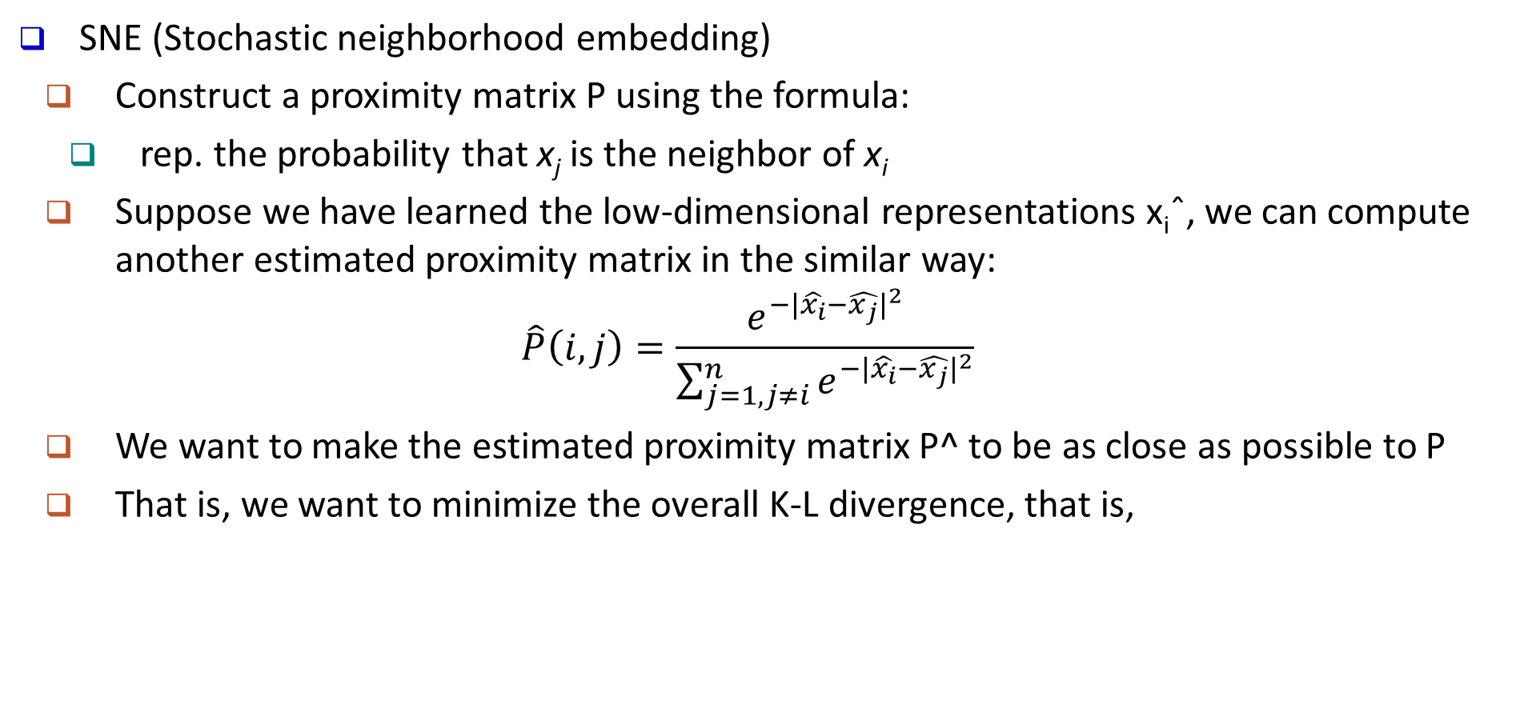
Nonlinear Dimensionality Reduction (II): SNE
SNE (Stochastic neighborhood embedding)
Construct a proximity matrix P using the formula:
rep. the probability that x_{j} is the neighbor of x_{i}
Suppose we have learned the low-dimensional representations x_{i}ˆ, we can compute another estimated proximity matrix in the similar way:
$$\hat{P}\left(i,j\right)=\frac{e^{−\left.|\hat{x_{i}}−\hat{x_{j}}\right.|^{2}}}{\sum_{j=1,j≠i}^{n}{e^{−\left.|\hat{x_{i}}−\hat{x_{j}}\right.|^{2}}}}$$
We want to make the estimated proximity matrix P^ to be as close as possible to P
That is, we want to minimize the overall K-L divergence, that is,

Slide 14
Nonlinear Dimensionality Reduction (II): SNE
SNE (Stochastic neighborhood embedding)
Construct a proximity matrix P using the formula:
rep. the probability that x_{j} is the neighbor of x_{i}
Suppose we have learned the low-dimensional representations x_{i}ˆ, we can compute another estimated proximity matrix in the similar way: Pˆ (i, j)
We want to make the estimated proximity matrix P^ to be as close as possible to P
That is, we want to minimize the overall K-L divergence, that is,

Slide 15
Example: Comparison on Nonlinear Data Points: Linear vs. Nonlinear Dimensional Reduction Methods
Visualization: An example of linear vs. nonlinear dimensionality reduction methods
Given a collection of input data in 2-D space (Fig. (a)): Red and blue data points are not linearly separable
PCA transformation can not make it linearly separable
KPCA can make the points linearly separable
t-SNE (t-distributional NSE) can make them linearly separable

Slide 16
Heatmap of the Proximity Matrices: Linear vs. Nonlinear Dimensional Reduction Methods
The heatmaps of the proximity matrices in PCA (a), KPCA (b), and t-SNE(c)
The two diagonal blocks indicate the proximity within the two clusters respectively
The two off-diagonal blocks indicate the proximity between the data from the two clusters
With nonlinear methods (KPCA and t-SNE), the proximity between data tuples from the same cluster is much higher than the proximity between data tuples from different clusters

Slide 17
Chapter 7. Classification: Advanced Methods
Feature Selection
Bayesian Belief Networks
Support Vector Machines
Rule-Based and Pattern-Based Classification
Weakly Supervised Learning
Classification with Rich Data Type
Other Related Techniques
Notes:
17

Slide 18
Feature Selection & Feature Engineering
Feature Selection
Given a set of p initial features, how to select a few most effective ones?
Why?
Irrelevant features (student ID for predicting GPA)
Redundant features (monthly income vs. yearly income)
Feature Engineering
Given the initial features, how to construct more effective ones?
# of daily positive cases, # of daily tests, # of daily hospitalization → weekly positive rate
(traditionally) domain knowledge is the key
Deep learning provides an automatic way

Slide 19
Feature Selection Methods
Filter methods
Select features based on some goodness measure
Independent of the specific classification model
Wrapper methods
Combine the feature selection and classifier model construction steps together,
Iteratively
Use the currently selected feature subset to construct a classification model
Use the current classification model to update the selected feature subset.
Embedded methods
Simultaneously constructs the classification model and selects the relevant features
Embed the feature selection step during the classification model construction step

Slide 20
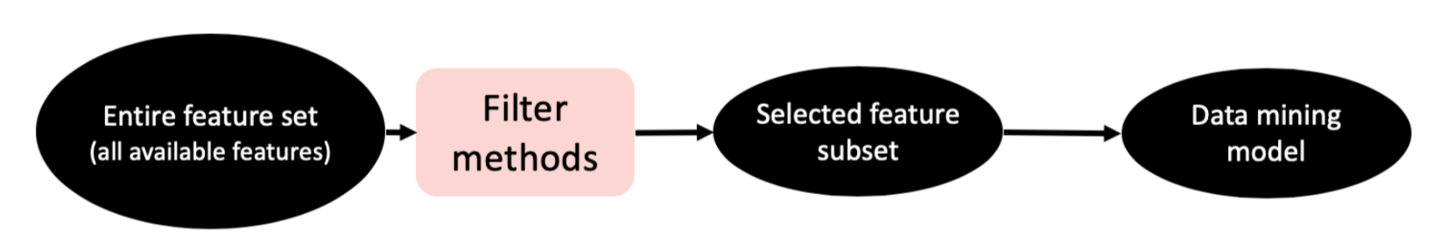
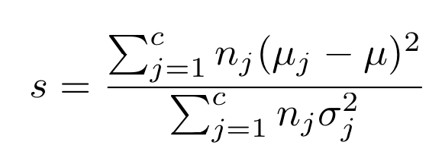
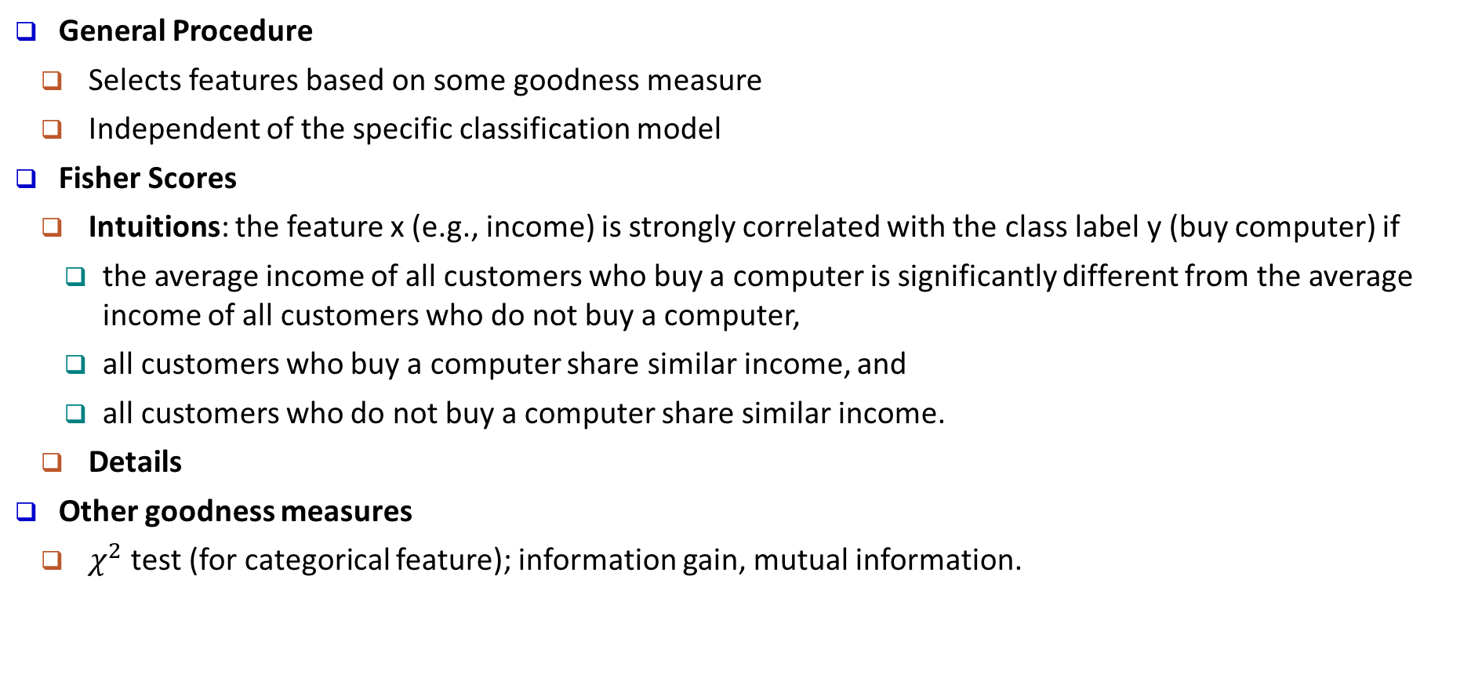
Filter Methods
General Procedure
Selects features based on some goodness measure
Independent of the specific classification model
Fisher Scores
Intuitions: the feature x (e.g., income) is strongly correlated with the class label y (buy computer) if
the average income of all customers who buy a computer is significantly different from the average income of all customers who do not buy a computer,
all customers who buy a computer share similar income, and
all customers who do not buy a computer share similar income.
Details
Other goodness measures
$χ^{2}$ test (for categorical feature); information gain, mutual information.

Slide 21
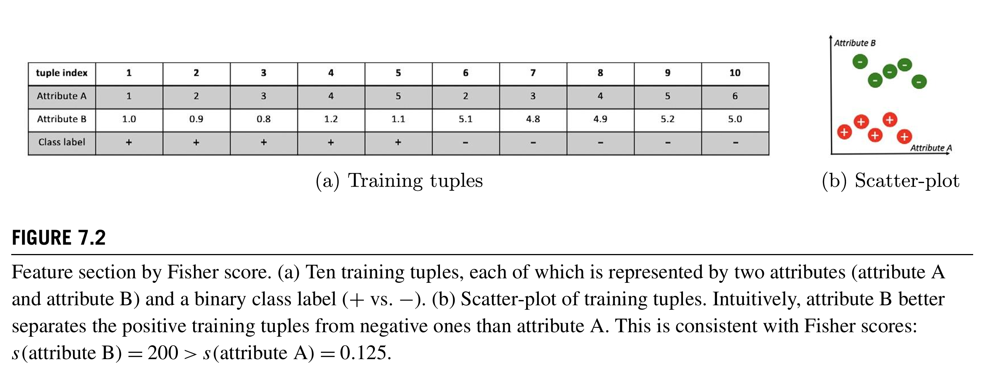
Filter Methods

Slide 22
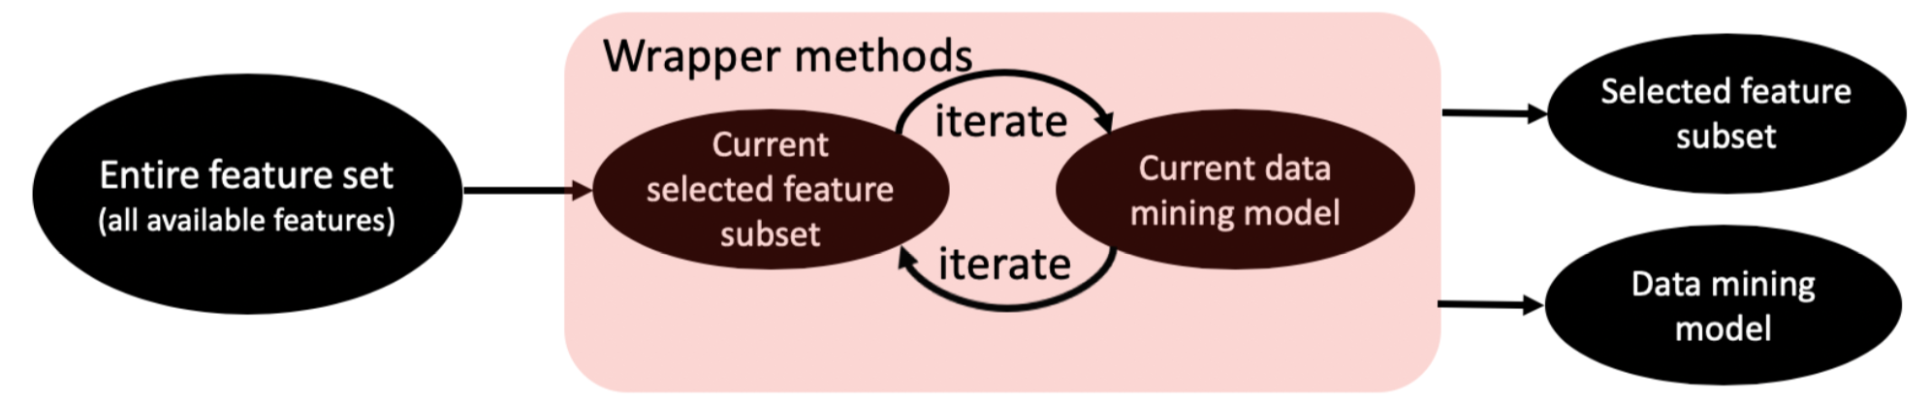
Wrapper Methods
General Procedure
Combines the feature selection and classifier model construction steps together,
Iteratively
Use the currently selected feature subset to construct a classification model
Use the current classification model to update the selected feature subset.
Key: how to search for the best feature subset
Exhaustive search: 2^{p}-1 (exponential)
Stepwise forward selection:
Start with an empty feature subset.
At each iteration, select an additional feature to improve performance most
Stepwise backward elimination: start with the full set, eliminate one feature at a time
Hybrid method

Slide 23
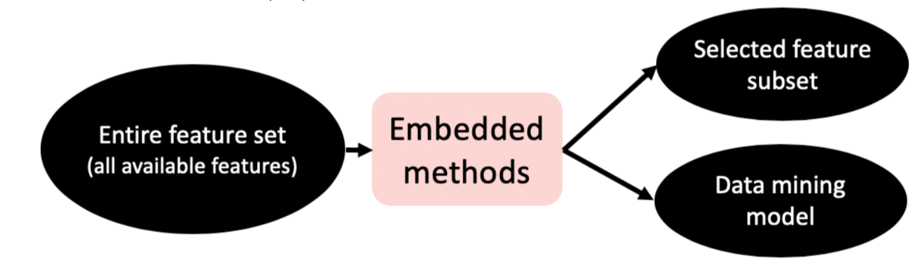

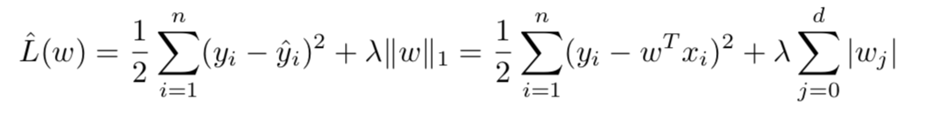
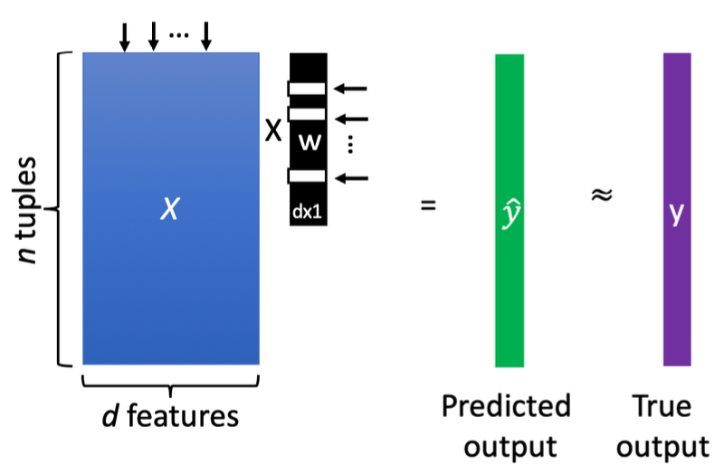
Embedded Methods
General Procedure
Simultaneously constructs the classification model and selects the relevant features
Embed the feature selection step during the classification model construction step
LASSO: Least Absolute Shrinkage and Selection Operator
Model
Training: Coordinate descent
(convex) approximation
of # of selected features
Goodness of prediction

Slide 24
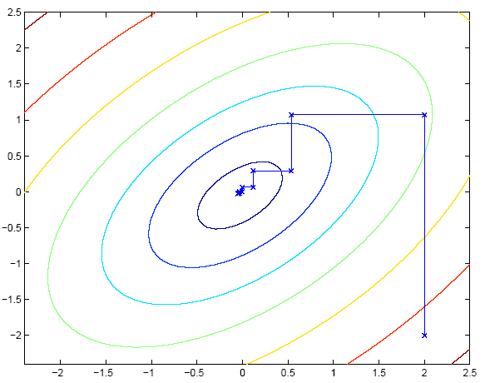
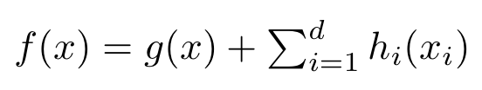
Coordinate Descent: Minimize f(x)
If f(x) is convex and smooth → global minima
If f(x) is convex but not differential → no guarantee on optimality
If f(x) is convex but not differential, but separable → global minima
g(x): convex and smooth
Each h_{i}(x): convex (but maybe non-smooth)

Slide 25
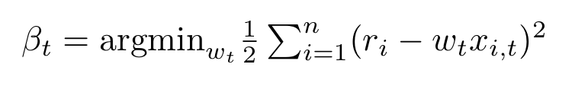
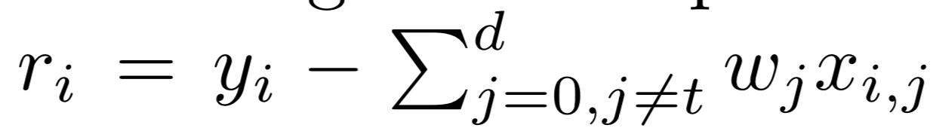
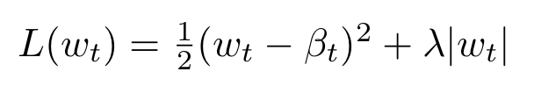

Coordinate Descent for Lasso
LASSO: Least Absolute Shrinkage and Selection Operator
Training: at each iteration, update one coefficient (w_{t}) while fixing others
Solve a least square regression problem, single dimension input (x_{i,t}) and output r
Solve the following optimization problem (quadratic, single variable)
assume each feature is normalized:

Slide 26
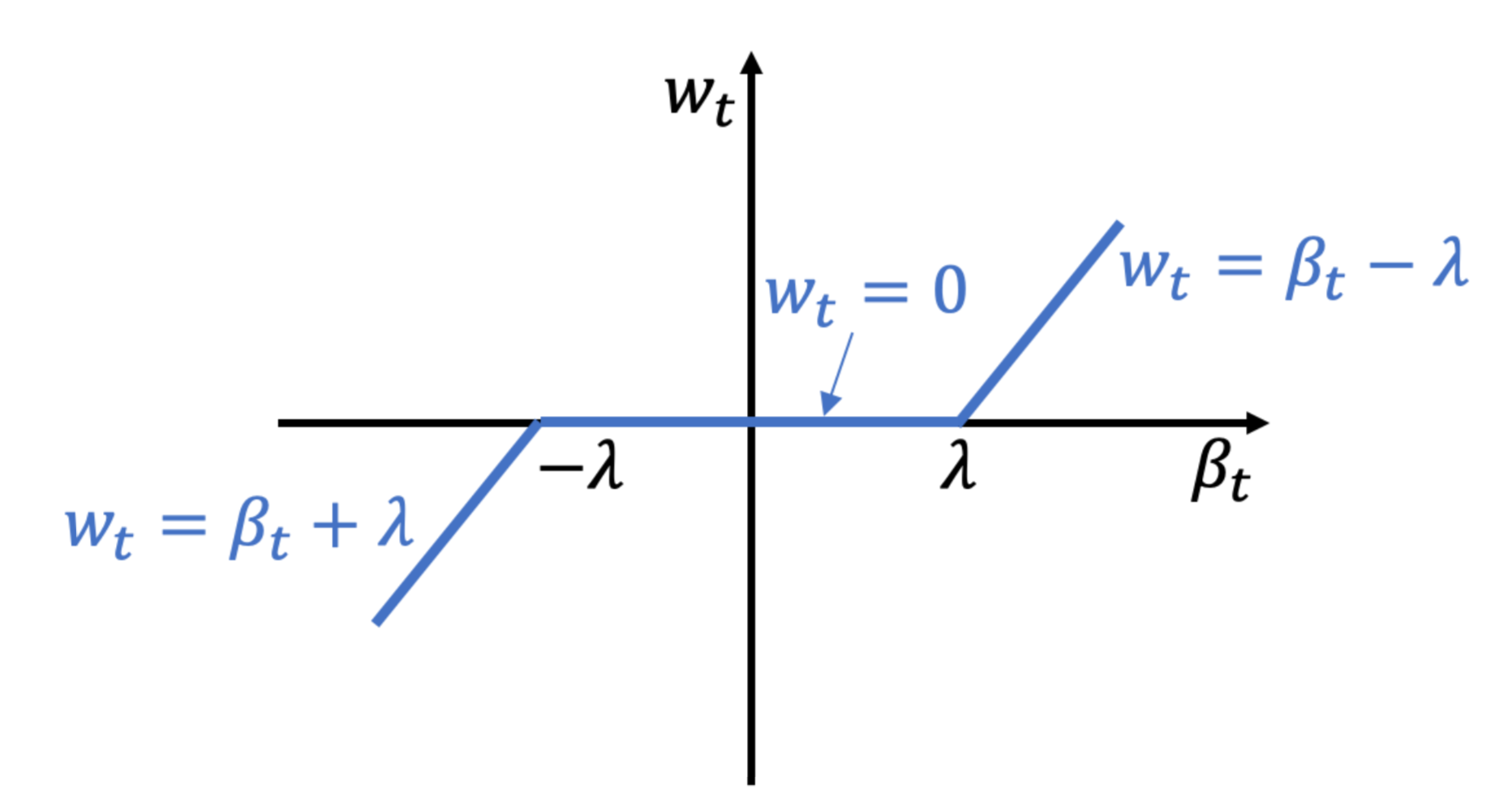
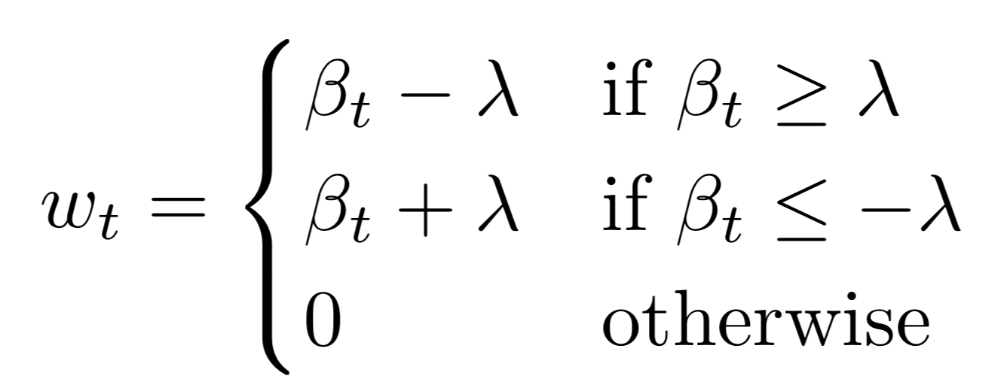

Coordinate Descent for Lasso
Solve the following optimization problem (quadratic, single variable)
Solution: soft-thresholding
Intuition: push the magnitude of toward 0

Slide 27


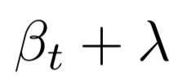



Soft Thresholding
Solve the following optimization problem (quadratic, single variable)

Slide 28
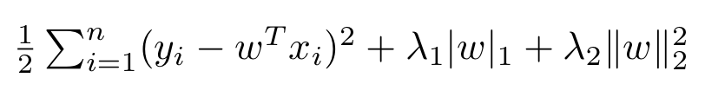
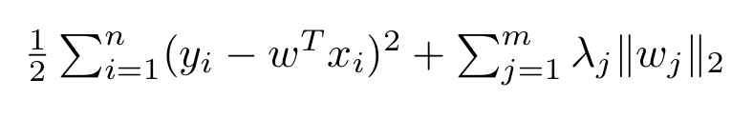
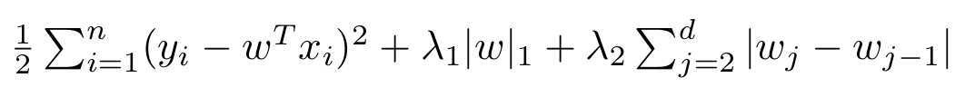
Beyond Lasso: Sparse Learning
Elastic net: L1+L2 regularization (i.e., ridge + lasso)
Group Lasso
Encourage a group of features to be unselected simultaneously
w_{j} : coefficient vector for a group of features (group j)
L₂ norm within each group; L₁ norm across groups
Fused Lasso
Encourage co-select (or co-un-select) adjacent features
Many more: e.g., graph-guided lasso, graphical lasso, matrix completion
…

Slide 29
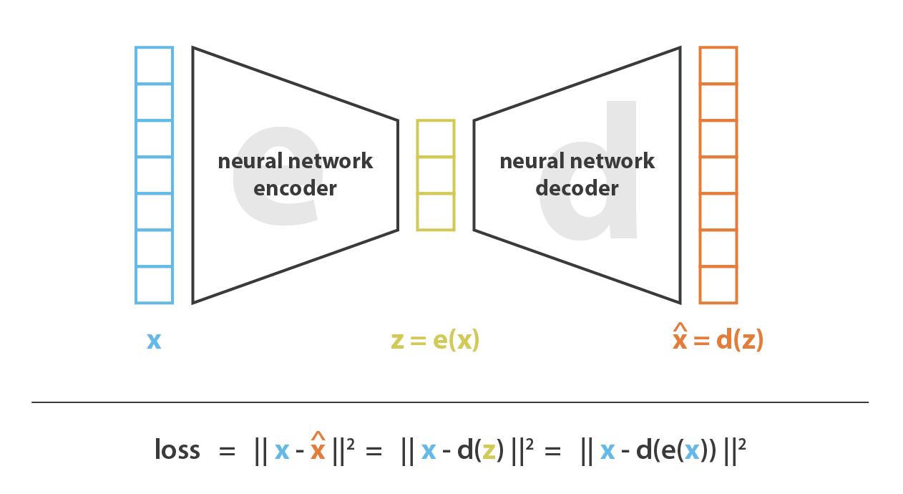
Dimensionality reduction : AutoEncoder, AE
Encoder, Decoder
Lossy encoding
AutoEncoder

Slide 30
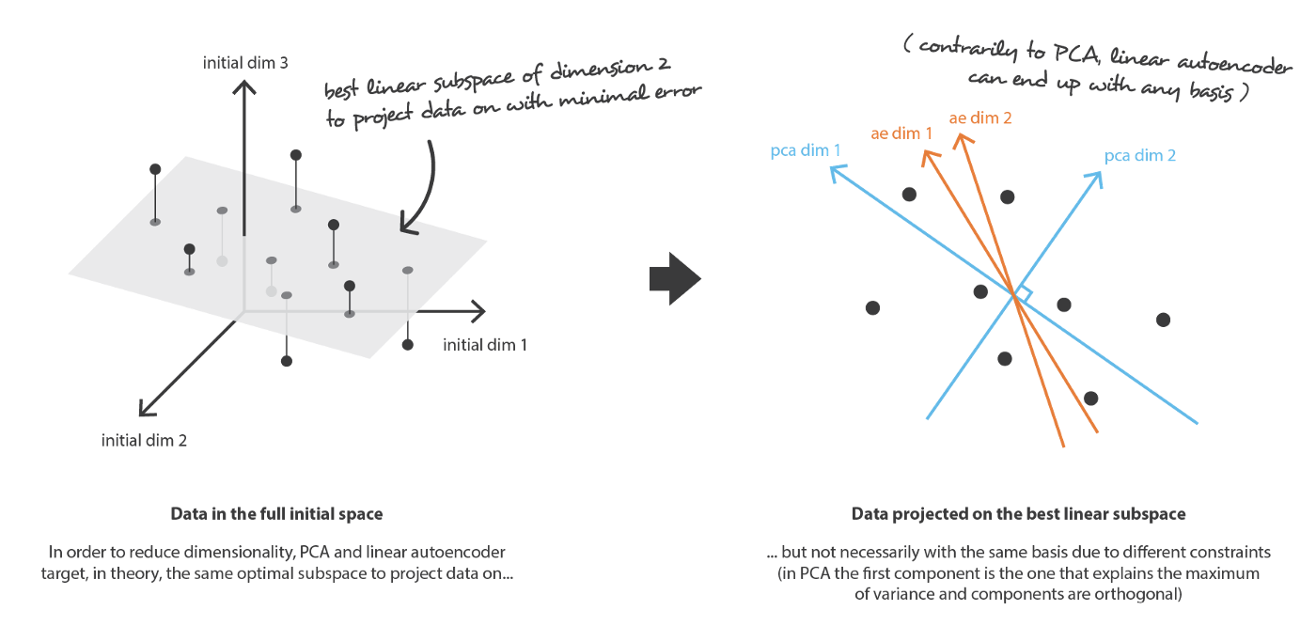
Dimensionality reduction : PCA vs AE

Slide 31
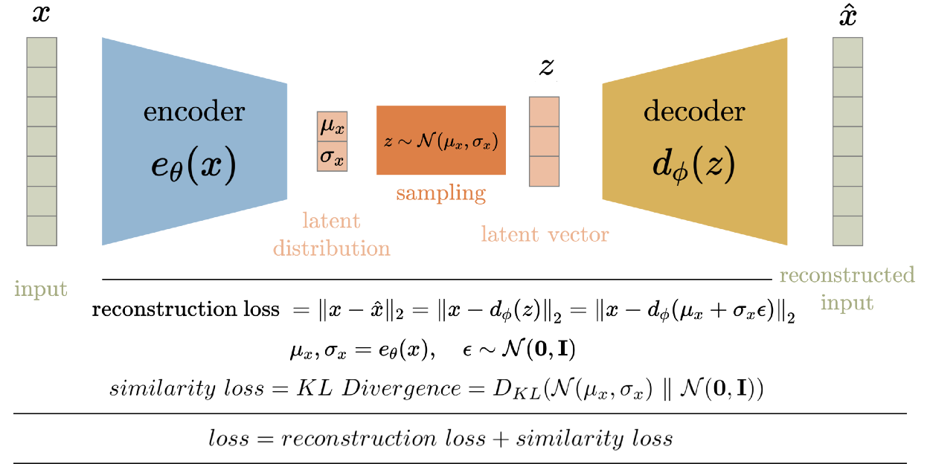
Variational AutoEncoder, VAE

Slide 32
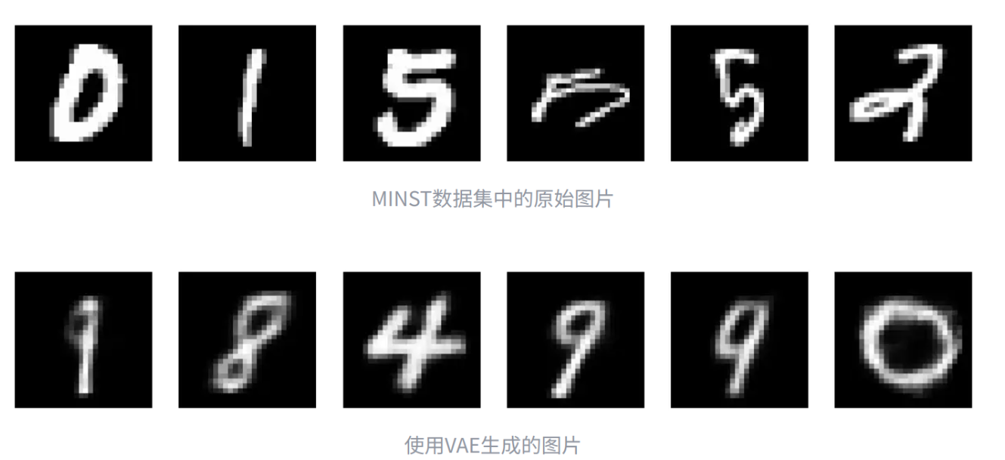
Variational AutoEncoder, VAE
VAE as generative model

Slide 33
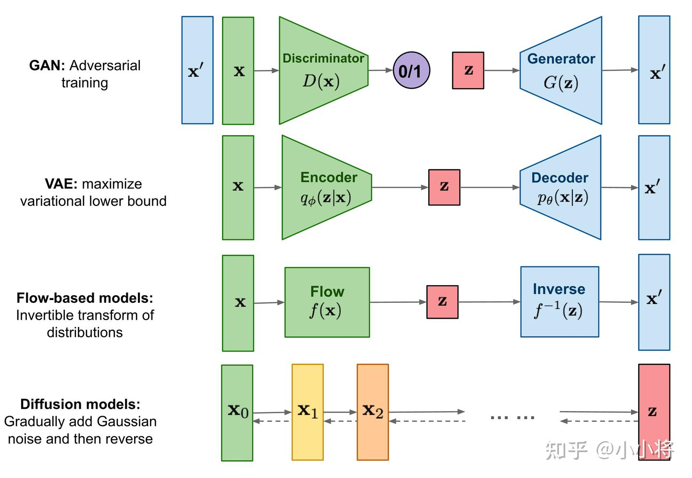
Generative Models

Slide 34
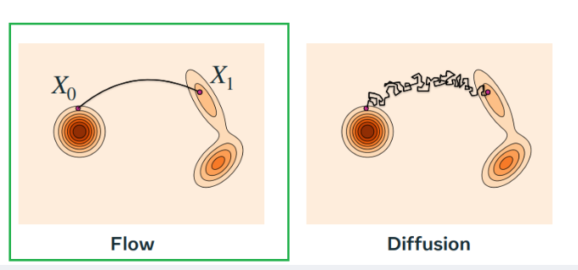
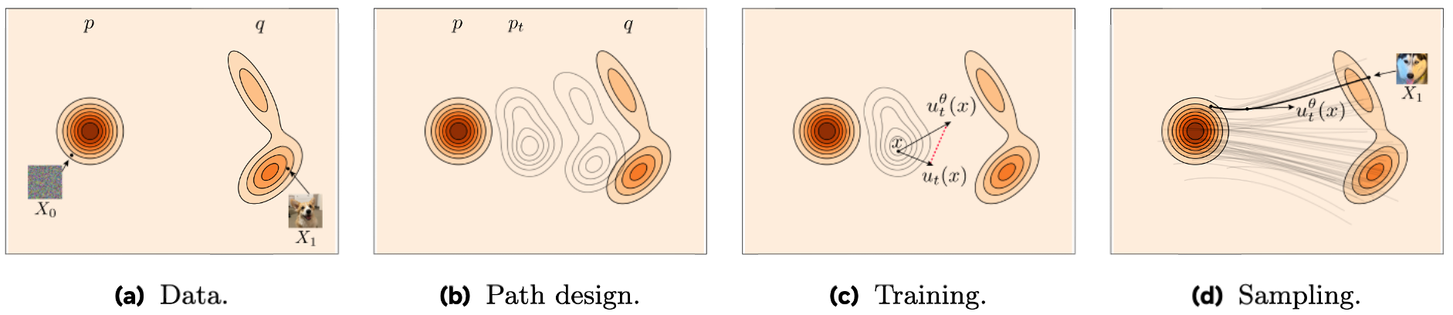
Generative Models
Auto Regressive
Flow Matching

Slide 35
Summary
Dimensionality reduction methodologies
Principal Component Analysis (PCA), attribute subset selection, and nonlinear dimensionality reduction
Feature Selection: Filter methods, wrapper methods and embedded methods
AutoEncoder, Variational
Generative Models

